Slide 1
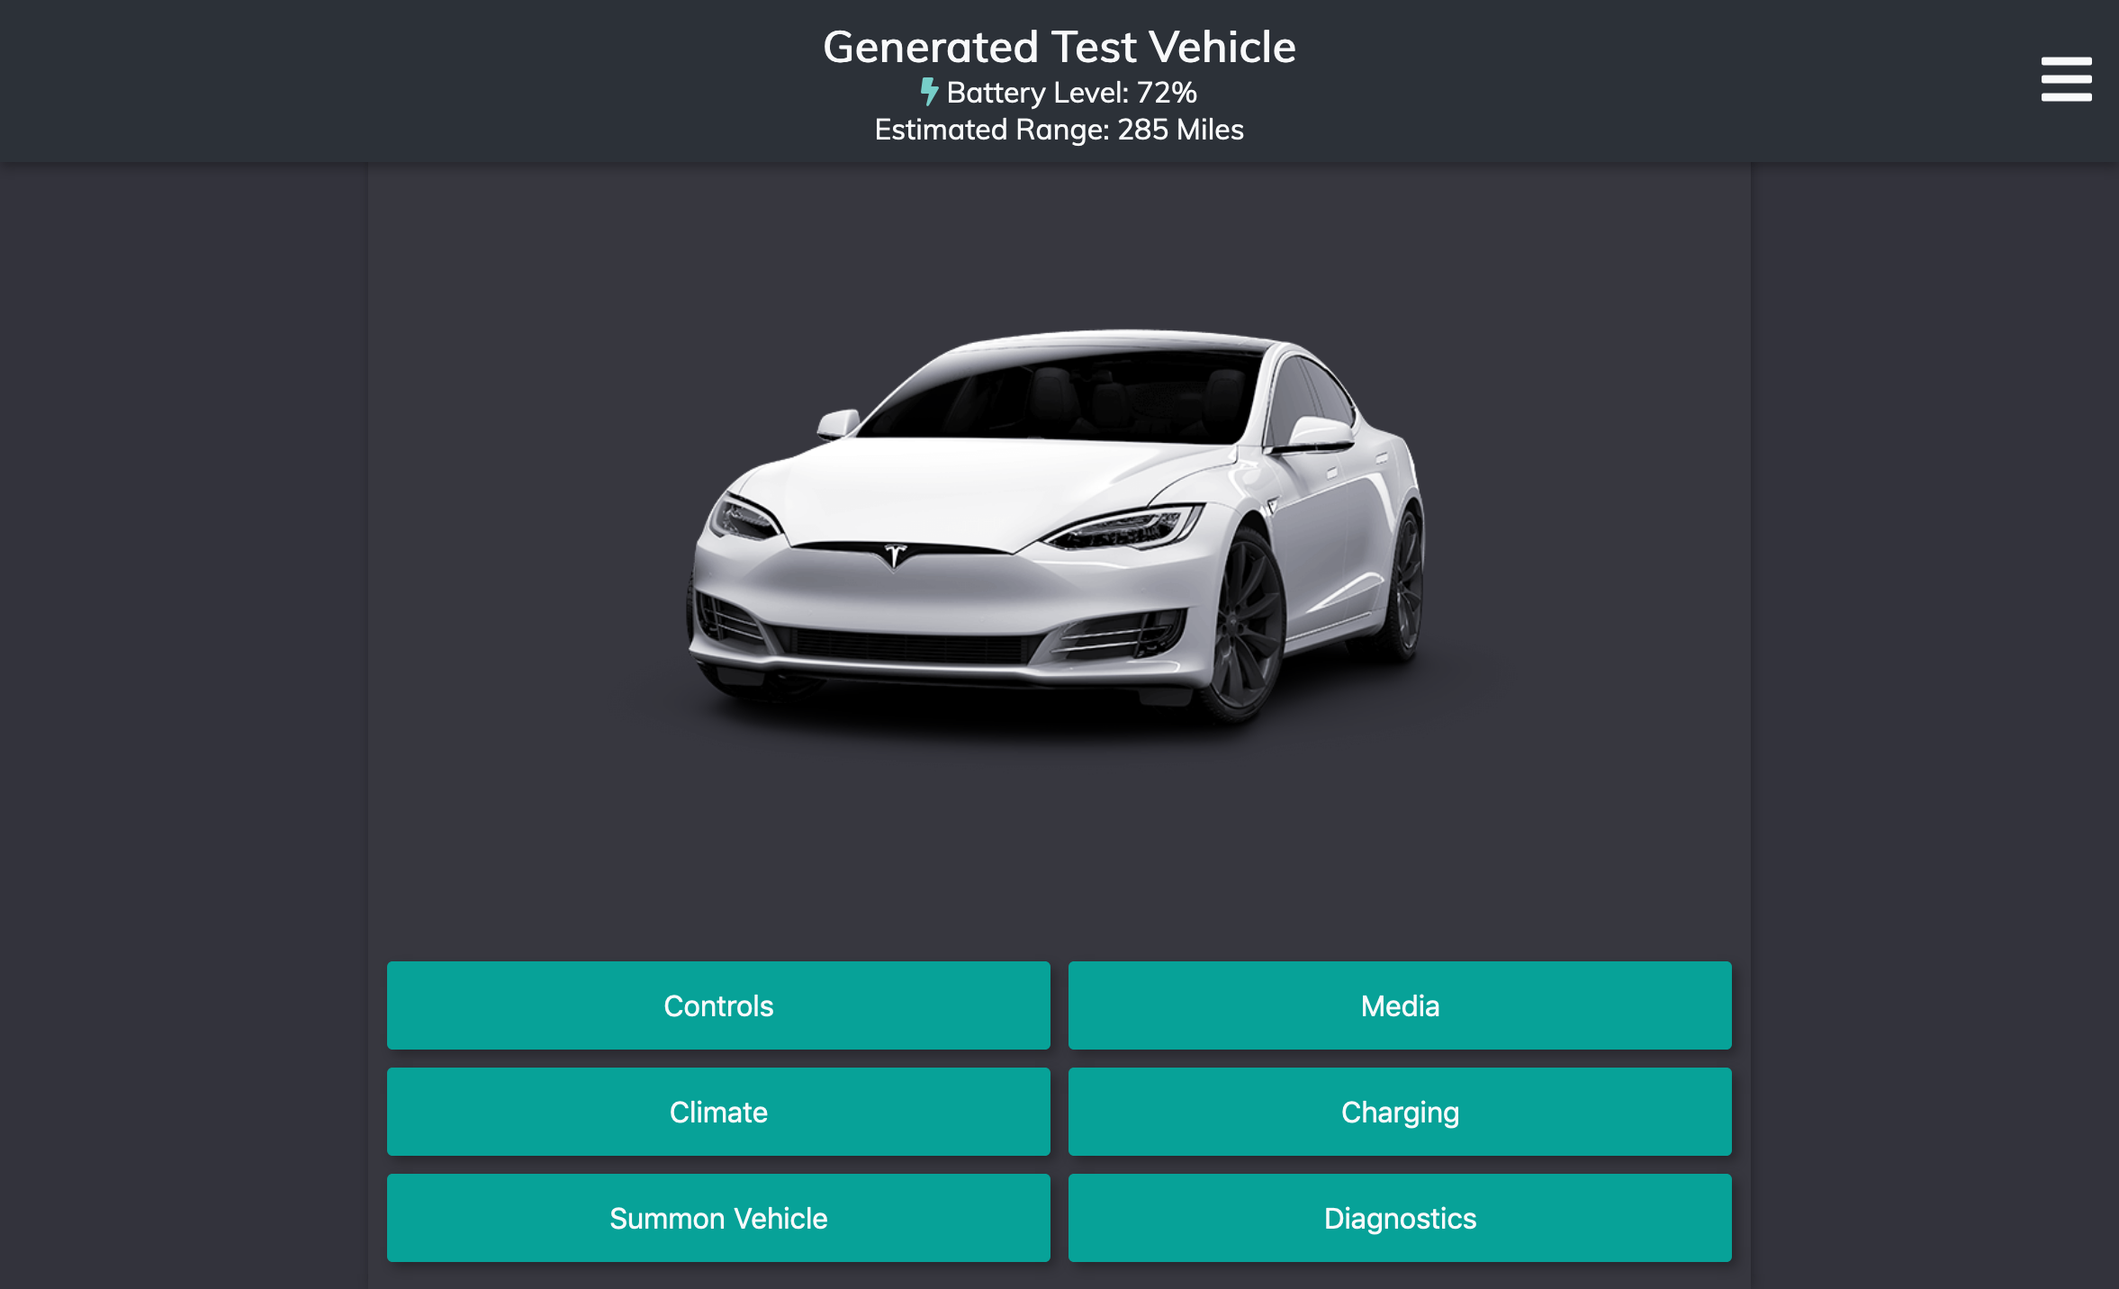
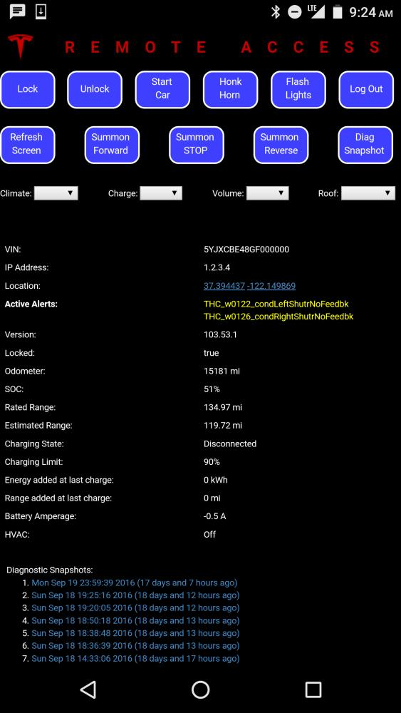
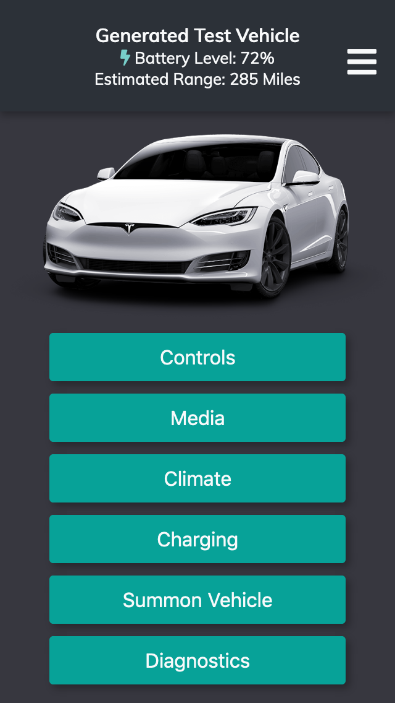
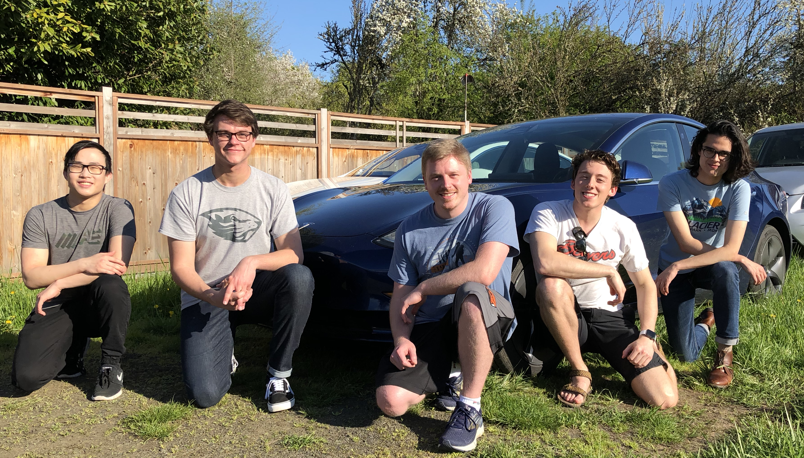
Group #22
DOWN BUT NOT OUT
Tesla Web Application
FINISHED RESULTS
When a Tesla vehicle is totaled due to an accident, Tesla refuses to continue supporting the vehicle and software. Even if a vehicle is repaired, it loses access to Tesla servers.
In order to restore a mobile application for these Tesla owners, we paired with Phil Sadow of Ingineerix, to improve on his initial version of the application. This app would run on Ingineerix servers and trick Tesla vehicles into believing they were talking to Tesla servers.
Due to other commitments Ingineerix had, the focus of the app was moved to parity with the Tesla mobile app. We then partnered with Otmar Ebenhoech of Café Electric, LLC, for technical support and providing a testing environment.
The web app now uses strictly Tesla API and communicates with the vehicle through Tesla servers. While access is currently denied to totaled vehicles, the application is designed to eventually be implemented in Ingineerix servers.
In the meantime, the web app will be an open source project hosted by Café Electric, LLC.
This application has restored the mobile functionality that is seen in the first party application by Tesla
Features Implemented:
Start Engine
Lock/Unlock Vehicle
Honk Horn
Flash Lights
Open Trunk & Frunk
Open Sunroof
Climate Control
Seat Heating
Media Controls
Setting Max Charge
Starting/Stopping Charging
Printing Diagnostic Information (Vehicle, Drive, Charge & Climate State, w/ Vehicle and GUI Settings)
(BETA) Summon Functionality
Design is similar to that of Tesla’s own to help users become familiar with where features are and how features work
Even after a totaled Tesla vehicle is repaired, owners lose the ability to connect to their vehicle remotely. This application seeks to fix that.
Desktop view of our application
The Team
STYLING & DESIGN
SERVER & COMMUNICATION
The front end of this application is built using ReactJS components. These components include things like header bars and side menus that combine to form the entire page. This made the page modular and easy to experiment with.
The styling of the page is done using Sass, which is compiled into CSS code.
Usability is one of the main goals of this application, and it uses dynamic page loading, graphics, and a mobile optimized view to ensure a good user experience.
We developed our server using the NodeJS framework, which had strong security boosts as well as a close connection to existing community infrastructure.
We extensively used the TeslaJS library that encapsulates the Tesla RESTful API, which is the main API that Tesla vehicles use to connect to Tesla servers.
Car data is stored in a JSON object that holds a variety of diagnostic information, user statistics, and other information about the vehicle.
This car JSON object gets updated every 10 seconds with the state of the vehicle and is displayed to the user.
Original Ingineerix Mobile Design
Our New Mobile Design
Brett Case -- brett.case97@gmail.com
Burton Jaursch -- burton.jaursch@gmail.com
Chris Jansen -- jansench@oregonstate.edu
Alex Morefield -- morefiea@oregonstate.edu
James Zeng -- jzeng1996@gmail.com

